Slide 1

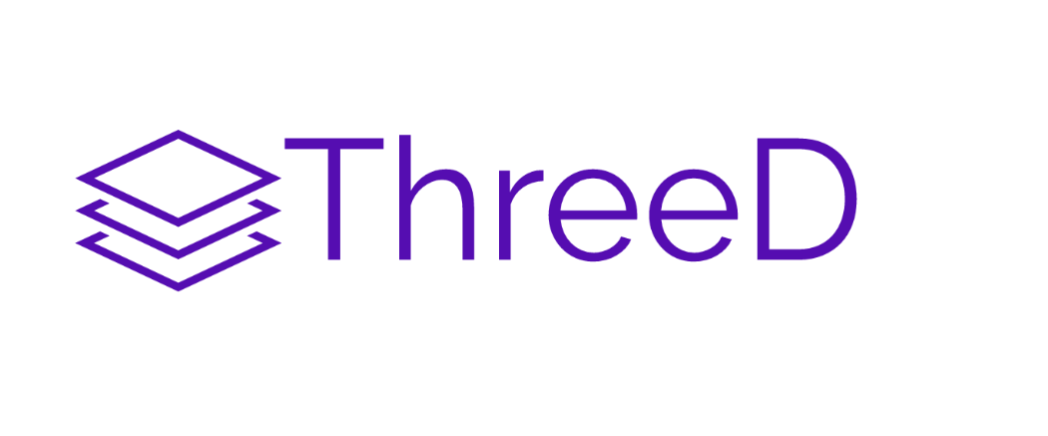
Additive Manufacturing Service Provider
John O Mahony
R00060080

Slide 2
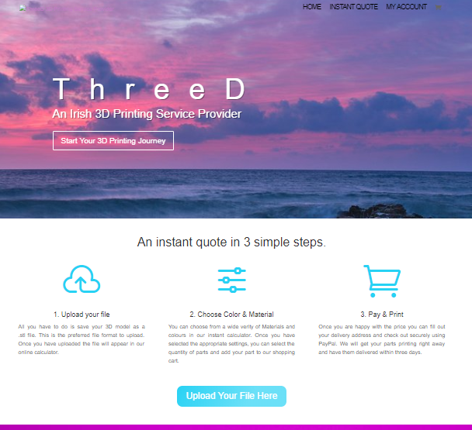
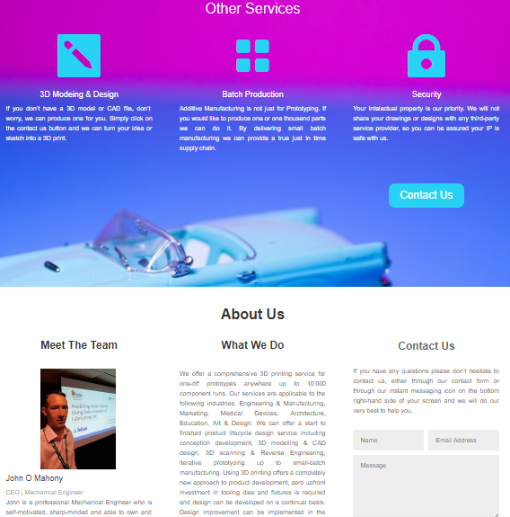
ThreeD
What is ThreeD
One off prototypes,
E-commerce platform,
Instant quote calculator,
The direction for ThreeD
Small batch manufacturing
Just In Time supply chain JIT
Total manufacturing freedom
https://threed.ie/

Slide 3
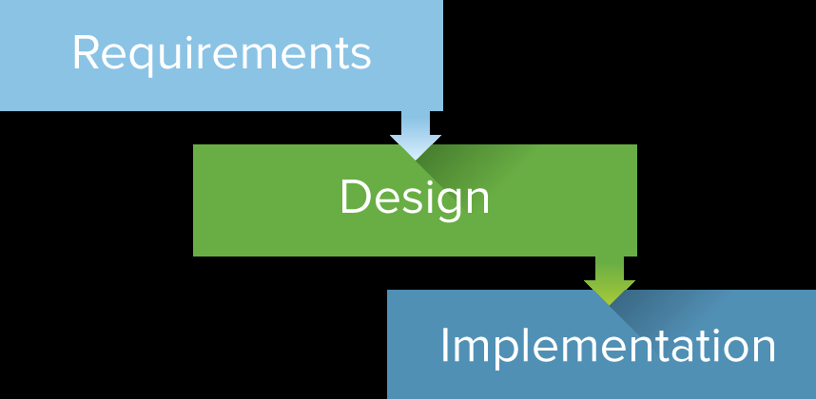

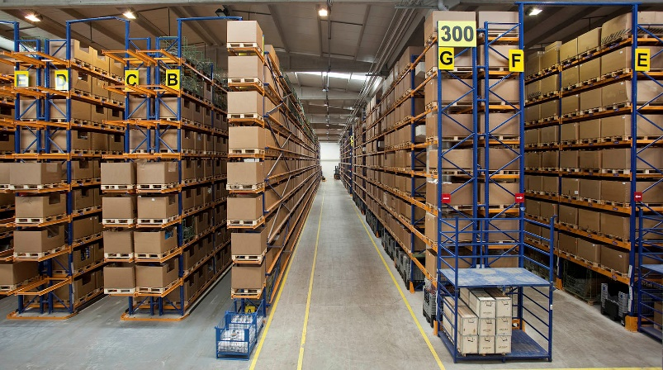

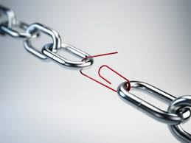
The Problem
Notes:
• Water fall product development.
• Large upfront investment in process.
• Capital tied up in stagnant stock.
• Inaccurate forecasting.
• Complex supply chains.
• Heavily reliant on external economies.

Slide 4
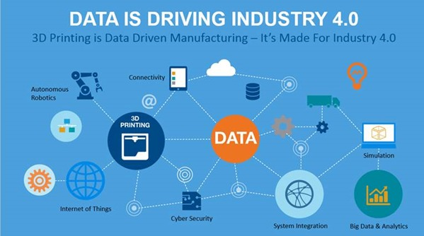
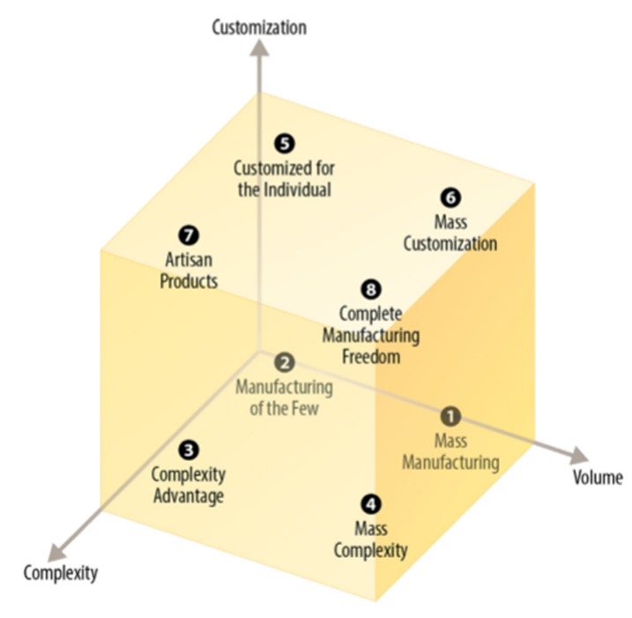
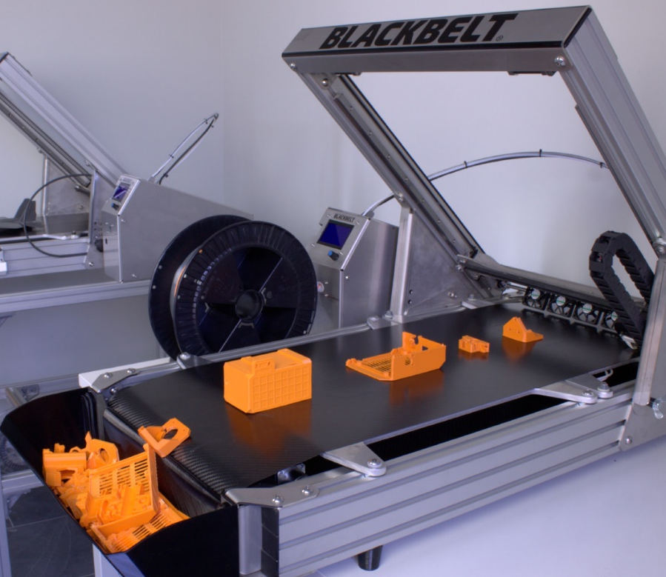
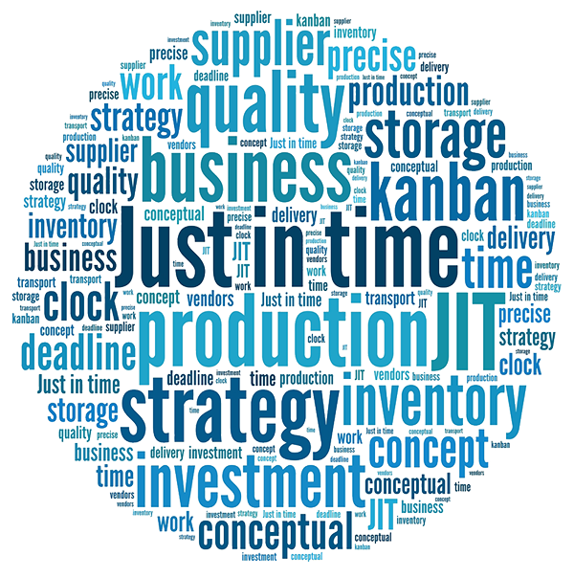
The Solution
1. Conner et al. (2014)
Conner B, Manogharan G, Martof A, Rodomsky L, Rodomsky C, Jordan D, imperos J, (2014). Making sense of 3-D printing: Creating a map of additive manufacturing products and services. Additive Manufacturing 1-4 (2014), pp. 64-76.
Notes:
Total Manufacturing freedom
One machine endless design ideas
Economy of one /scope
JIT Supply chain
Flexible manufacturing model
Industry 4.0 Technology

Slide 5
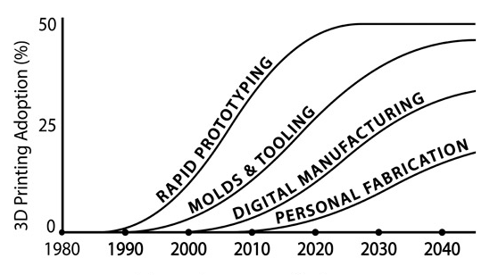
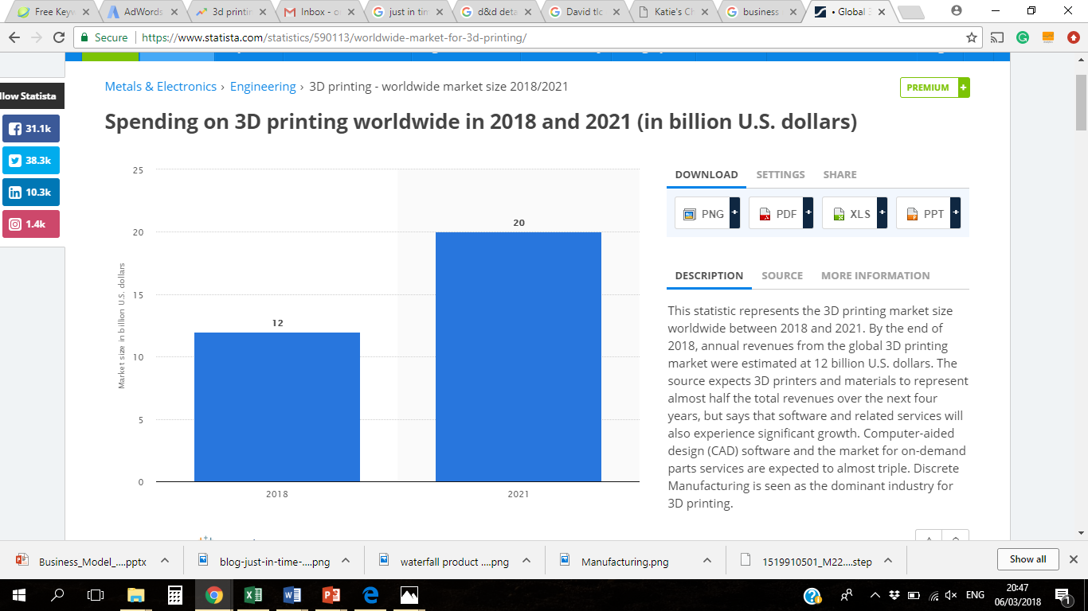
Market Size
This statistic represents the 3D printing market size worldwide between 2018 and 2021. By the end of 2018, annual revenues from the global 3D printing market were estimated at 12 billion U.S. dollars. The source expects 3D printers and materials to represent almost half the total revenues over the next four years, but says that software and related services will also experience significant growth. Computer-aided design (CAD) software and the market for on-demand parts services are expected to almost triple. Discrete Manufacturing is seen as the dominant industry for 3D printing.
http://explainingthefuture.com/3dprinting.html
https://www.statista.com/statistics/590113/worldwide-market-for-3d-printing/
https://www.statista.com/statistics/590113/worldwide-market-for-3d-printing/

Slide 6
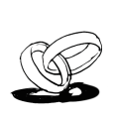
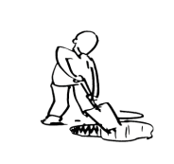


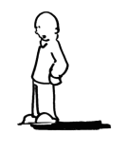

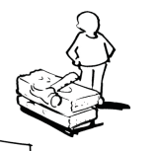
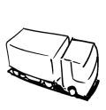

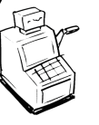

Business Model
Key Partners | Key Activities | Value Propositions |  | Customer Relationships | Customer Segments
 | Key Resources |  |  | Channels
Cost Structure |  |  | Revenue Streams
Social & Environmental Cost |  |  | Social & Environmental Benefit
http://www.businessmodelgeneration.com
P1. One off prototyping sales.
P2. Batch production up to 10’000 part runs
P3. Just In time Supply chain management.
Deliver total manufacturing freedom (Customized, complex parts in volume production)
True Just In Time supply chain
Reduce time and cost to market,
virtual warehousing,
Long term relationship structure
Tailored to needs of the customer
On Demand manufacturing
Engineering,
Medical devices,
Pharmaceutical,
Consumer goods,
Marketing,
Art and design,
Architecture,
Education.
Rubicon Centre
Irish Manufacturing Research
G&C Creations
Enterprise Ireland
Local Enterprise Office
P1.
E-commerce
P2.
Direct to the customer
Sales & Marketing
Operations
R&D
Quality
Material volume + machine cost + overheads + % profit margin.
P1. One off sales.
P2. Reoccurring sales
Reduced Cardoon footprint in manufacturing
Increased Manufacturing economic stability in Ireland
Reduced waste

Slide 7
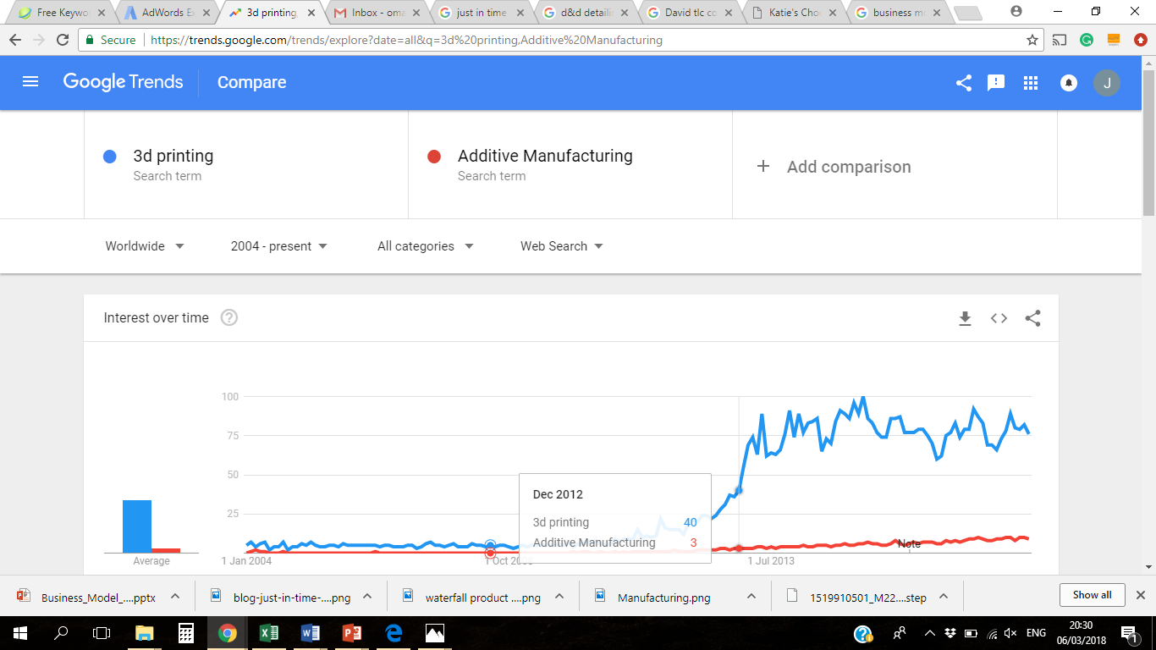
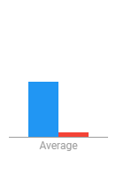
Reach
P1. ThreeD.ie
E-commerce platform,
Instant quote calculator,
Ongoing.
SEO & Digital marketing campaign,
Information blog / Increase organic traffic,
P2.
Exhibiting & presenting/ networking at conferences & trade show's in Ireland,
Re Marketing and follow up calls,
Cold calling potential justified leads,
Social - LinkedIn, Twitter, Facebook, Instagram
https://trends.google.com/trends/explore?date=all&q=3d%20printing,Additive%20Manufacturing

Slide 8
Competitor Analysis
 | 3D Printing Primary Business | Location | Volume Production | Google search 3d printing Ireland | Website lay out | Instant web quoting | Total
3D PRINTING DUBLIN | Y | Dublin | Y | 1 | Moderate | N | 3
3D PRINTING IRELAND | Y | Dublin, Meath | N | 2 | User Frendly | N | 3
INSPIRE 3D | Y | Wicklow | Y | 3 | Moderate | N | 3
BELIEVE 3D PRINTING | Y | Fermannagh, Belfast | N | 6 | User Frendly | Y | 3
WAZP | Y | Kerry | Y | 7 | User Frendly | N | 3
UA 3D PRINTING | Y | Galway | N | 5 | Complex | Y | 2
SCHIVO GROUP LIMITED | N | Waterford | Y | 8 | User Friendly | N | 2
3DP | Y | Sligo | Y | Not on first page | Moderate | Y | 2
HACKETT 3D | N | Dublin | N | 4 | User Friendly | N | 1
NERATEK LIMITED | Y | Sligo | N | 9 | Complex | N | 1
3D PRINTING POINT | Y | Galway | N | Not on first page | Complex | N | 1
CT SCANNING AND 3D PRINTING | Y | Tipperary | N | Not on first page | Complex | N | 1

Slide 9
Strategy
Short Term
1 - 6 Months
Launch ThreeD.ie
Digital marketing campaign,
Market research,
Organic web traffic,
SEO,
Long Term
19 - 36 Months
Fundraising for business expansion
Iso:9001 accreditation
Investment in industrial equipment.
Investigate JIT supply chain solution
Medium Term
7 - 18 Months
Re-market to P1 customers
Build Print Farm
Develop sales pipeline
Exhibitions & Tradeshows
Ongoing digital marketing & SEO
Notes:
Christine

Slide 10
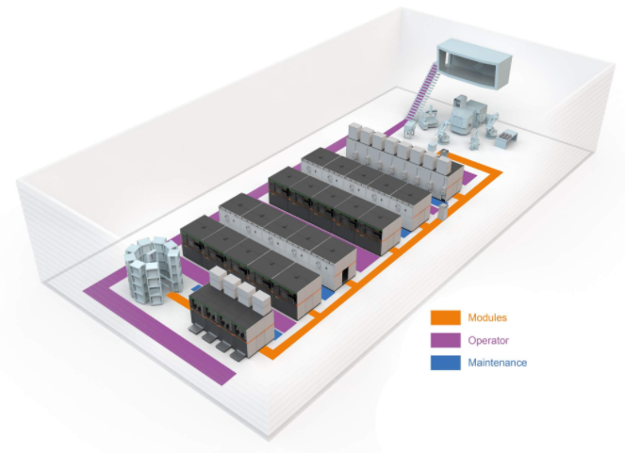
In Summary
ThreeD has the potential to:
Deliver true JIT manufacturing (Just in time),
Deliver total manufacturing freedom,
Speed up time to market,
Reduce waste,
Increase economic stability in Ireland,
Obstacles.
Large capital investment,
Continually evolving equipment/ technology,
GE Factory of the future

Slide 11
Thanks for your time.

